Slide 2
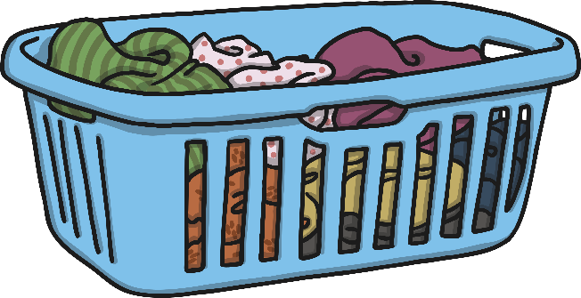
Next
I
no
the
to
go
into
Click the basket to reveal a word.

Slide 3
Next
he
me
she
we
Click the basket to reveal a word.

Slide 4
Next
be
her
you
are
Click the basket to reveal a word.

Slide 5
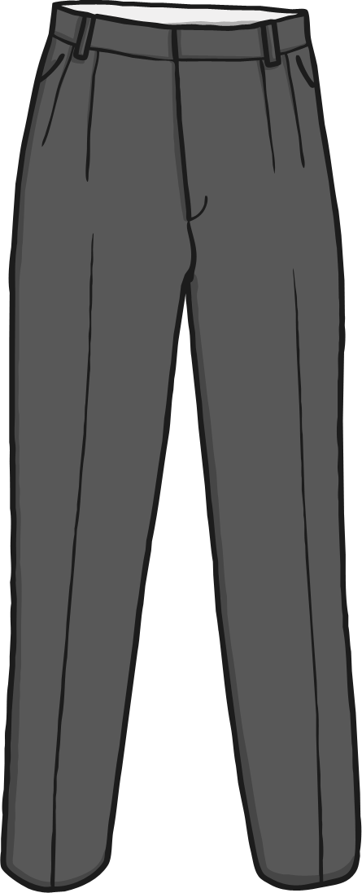
Finish
was
all
they
my
Click the basket to reveal a word.

